Slide 1


Chatbot Application
Easy to start, hard to master
Dr. Damian Petrecki, BEng, Msc, PhD
Grape Up Sp. z o.o. | Kraków, Poland | damian.petrecki@grapeup.com

Slide 2






Agenda
What is it about?
Different models for different tasks
From „Hello World” to something useful
Traps and antipatterns
Application architecture

Slide 3
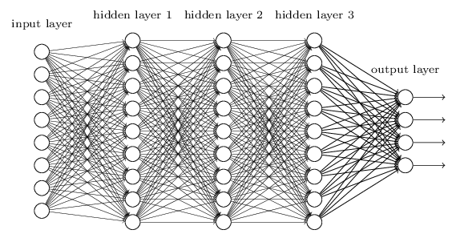
Important terms
Basics
Neural network: A computational model inspired by the workings of the biological brain, which is used primarily in the fields of artificial intelligence and machine learning. It consists of many interconnected units called neurons or nodes. These units are organized into layers that process input data and then pass it on to subsequent layers in order to accomplish a specific task, such as image classification, speech recognition, value prediction, or decision‑making.
Artificial intelligence: A set of heuristic algorithms designed to solve zero‑shot problems, employing complex mathematical equations that include at least one random parameter and at least one parameter produced during the learning process.
LLM (Large Language Model): a type of artificial intelligence (AI) model that is based on an advanced neural network architecture—typically the transformer—and is trained on enormous text datasets. Its primary purpose is to understand, generate, and process human natural language. Thanks to its large number of parameters and the scale of its training data, an LLM can answer questions, translate texts, write articles, engage in conversations, and perform other language‑related tasks.

Slide 4
Embedding
y
Basics
dog
computer
giraffe
cat
x
Method: Embedding is a method of converting data (e.g., words, images) into numerical vectors. It’s the way learning models transform complex, raw data into a form that’s easier to analyze and process.
Process: The process of creating an embedding involves training a model to learn a representation of the data such that similar objects (e.g., words with related meanings) end up close to each other in the vector space.
Representation: “Embedding” also refers to the resulting vectors produced by this conversion process. For example, after processing the word “king” through an embedding, you obtain its numerical-vector representation, which the model can then use for further computations.

Slide 5
Reading time
[1706.03762] Attention Is All You Need
GPT-3 vs. BERT - which is best? This article compares both in depth (softteco.com)
https://miroslawmamczur.pl/czym-jest-i-jak-dziala-transformer-siec-neuronowa/ [PL]

Slide 6
Behind GPT
OpenAI
Embedding
Ada 2, text-embedding-3
Audio
Whisper
tts-1, tts-1-hd, gpt-4o-mini-tts
Image
Dall-e 3, GPT-o4, GPT-4.1
Video
Sora

Slide 7
Behind OpenAI
LLM
Antropic Claude
Google Gemini
Amazon Titan
Meta Llama
Mistral
Hugging Face – The AI community building the future.
Supported foundation models in Amazon Bedrock - Amazon Bedrock

Slide 8
What else?
AI
Text to speech
ElevenLabs
Avatars
Synthesia
Canva
Sentiment
Komprehend (text)
Viso.ai (video)

Slide 9




Retrieval Augmented Generation (RAG)
Data
Data ingestion
Data search
The Assistant is as good as the data provided. The most common way to provide data to it, is hybrid search – vector and semantic combined search for documents „similar” to the user’s question
Quality
Performance

Slide 10


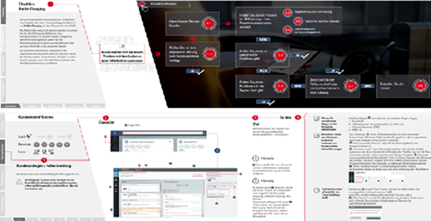
Yes, but…
Notes:
Video source: https://www.impossible-bureau.com/ PIT image source: Ministerstwo Finansów

Slide 11

More than RAG
Execute operations
User wants to know to replace real axle in Mercedes W214
Which manual to use?
How to provide answer?
How to use complex schemas?
User wants to lift the car a little bit more
Which API to call?
User wants to set the breaks into maintenance position
How to communicate with the software-defined car?
How to authorize the communication channel?
Notes:
Image source: Public Works Fleet Division, Greenville, | Free Photo - rawpixel

Slide 12
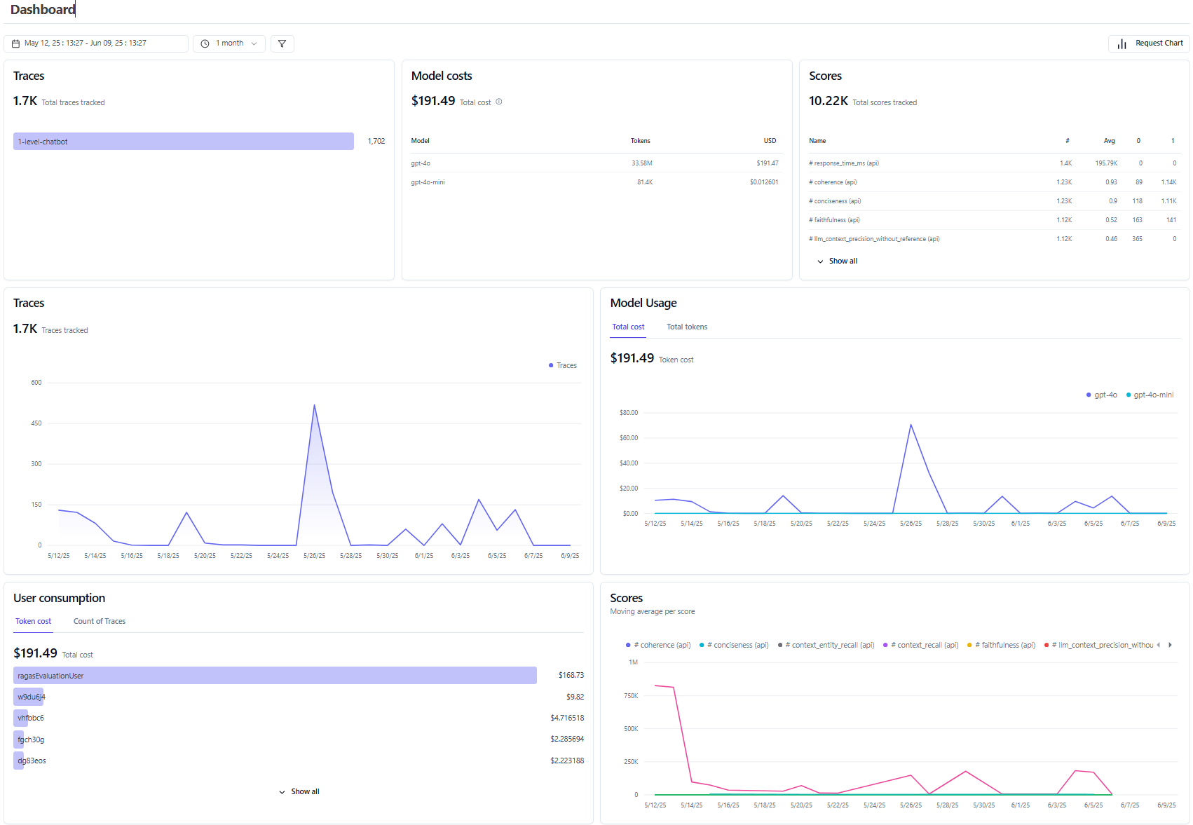
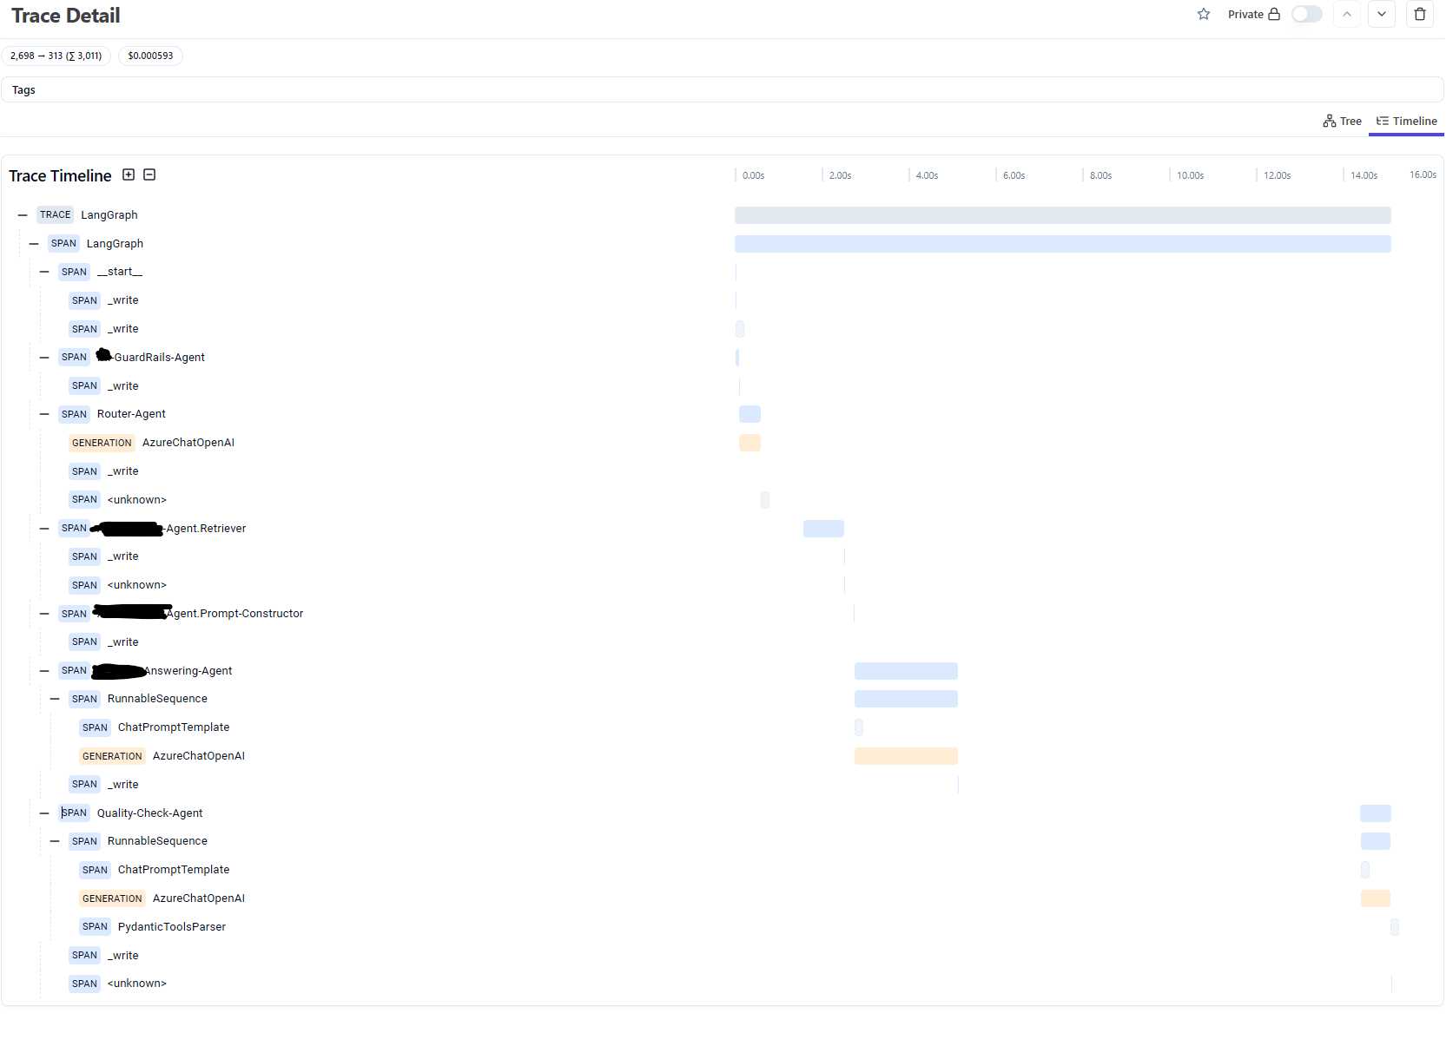
Langfuse
Traces, evals, prompt management and metrics to debug and improve your LLM application.
Langfuse Demo (10 minutes) - Langfuse

Slide 13
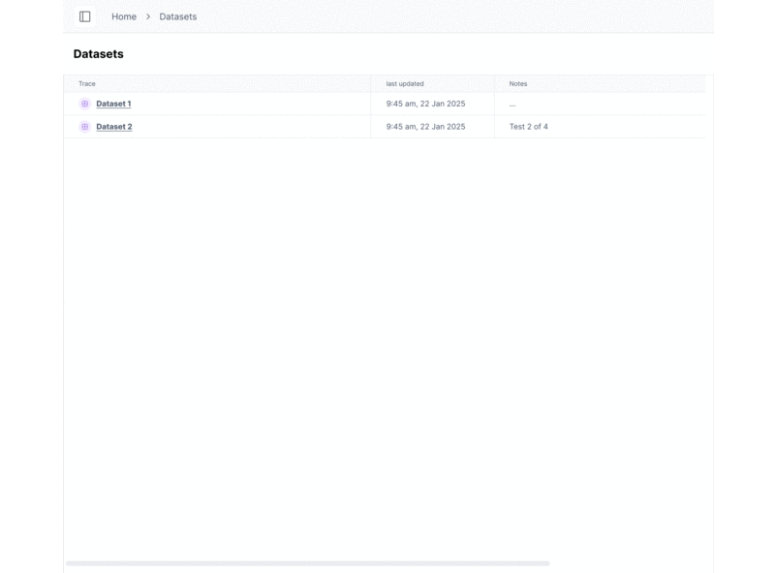
Ragas
Ragas is a library that provides tools to supercharge the evaluation of Large Language Model (LLM) applications. It is designed to help you evaluate your LLM applications with ease and confidence.
Notes:
Source: Ragas

Slide 14

Let’s write a chatbot!

Slide 15
Rest call
import requests
from fastapi import FastAPI
from pydantic import BaseModel
OPENAI_API_KEY = "YOUR_API_KEY_HERE"
API_URL = "https://api.openai.com/v1/chat/completions"
app = FastAPI()
conversation = [
{"role": "developer", "content": "You are a helpful assistant."}
]
class Message(BaseModel):
content: str
@app.post("/chat")
def chat(message: Message):
conversation.append({"role": "user", "content": message.content})
headers = {
"Authorization": f"Bearer {OPENAI_API_KEY}",
"Content-Type": "application/json"
}
data = {
"model": "gpt-4.1",
"messages": conversation
}
response = requests.post(API_URL, headers=headers, json=data)
reply = response.json()["choices"][0]["message"]["content"]
conversation.append({"role": "assistant", "content": reply})
return {"response": reply}
Version I

Slide 16
OpenAI API
Version II
from fastapi import FastAPI
from pydantic import BaseModel
from openai import OpenAI
OPENAI_API_KEY = "YOUR_API_KEY_HERE"
app = FastAPI()
client = OpenAI(api_key=OPENAI_API_KEY)
conversation = [
{"role": "developer", "content": "You are a helpful assistant."}
]
class Message(BaseModel):
content: str
@app.post("/chat")
def chat(message: Message):
conversation.append({"role": "user", "content": message.content})
completion = client.chat.completions.create(
model="gpt-4.1",
messages=conversation
)
reply = completion.choices[0].message.content
conversation.append({"role": "assistant", "content": reply})
return {"response": reply}

Slide 17
Langchain
Version III
import langgraph
from fastapi import FastAPI
from pydantic import BaseModel
OPENAI_API_KEY = "YOUR_API_KEY_HERE"
app = FastAPI()
client = langgraph.Client(api_key=OPENAI_API_KEY)
conversation = client.conversation(system_prompt="You are a helpful assistant.")
class Message(BaseModel):
content: str
@app.post("/chat")
def chat(message: Message):
conversation.add_user(message.content)
reply = conversation.generate()
return {"response": reply}

Slide 18
Java and Spring Boot
Version IV
@RestController
@RequestMapping("/chat")
public class ChatController {
private final OpenAIClient client;
private final List<ChatMessage> conversation;
public ChatController() {
client = new OpenAIClientBuilder()
.credential(new AzureKeyCredential("YOUR_API_KEY_HERE"))
.endpoint("https://YOUR_RESOURCE_NAME.openai.azure.com/")
.buildClient();
conversation = new ArrayList<>();
conversation.add(new ChatMessage(ChatRole.SYSTEM, "You are a helpful assistant."));
}
@PostMapping
public Map<String, String> chat(@RequestBody Map<String, String> payload) {
var userContent = payload.get("content");
conversation.add(new ChatMessage(ChatRole.USER, userContent));
var options = new ChatCompletionsOptions(conversation)
.setModel("gpt-4");
var result = client.getChatCompletions(options);
var reply = result.getChoices().get(0).getMessage().getContent();
conversation.add(new ChatMessage(ChatRole.ASSISTANT, reply));
return singletonMap("response", reply);
}
}

Slide 19
Let’s make an AI assistant of it!

Slide 20
Langchain + FAISS
from fastapi import FastAPI
from pydantic import BaseModel
from langchain.embeddings.openai import OpenAIEmbeddings
from langchain.vectorstores import FAISS
from langchain.chat_models import ChatOpenAI
from langchain.chains import ConversationalRetrievalChain
OPENAI_API_KEY = "YOUR_API_KEY_HERE"
app = FastAPI()
embeddings = OpenAIEmbeddings(openai_api_key=OPENAI_API_KEY)
vectorstore = FAISS.load_local("faiss_index", embeddings)
qa = ConversationalRetrievalChain.from_llm(
llm=ChatOpenAI(openai_api_key=OPENAI_API_KEY, model="gpt-4"),
retriever=vectorstore.as_retriever(search_kwargs={"k": 3})
)
chat_history = []
class Message(BaseModel):
content: str
@app.post("/chat")
def chat(message: Message):
result = qa({"question": message.content, "chat_history": chat_history})
chat_history.append((message.content, result["answer"]))
return {"response": result["answer"]}
Add data

Slide 21
Langfuse
Manually
from langfuse import Langfuse
langfuse = Langfuse()
trace = langfuse.trace( input="Hi there„,
name = "docs-retrieval",
user_id = "user__935d7d1d-8625-4ef4-8651-544613e7bd22",
metadata = {
"email": "user@langfuse.com",
},
tags = ["production"]
)
With decorator
from langfuse.decorators import observe
from langfuse.openai import openai # OpenAI integration
@observe()
def story():
return openai.chat.completions.create(
model="gpt-4o",
messages=[
{"role": "system", "content": "You are a great storyteller."},
{"role": "user", "content": "Once upon a time in a galaxy far, far away..."}
],
).choices[0].message.content
@observe()
def main():
return story()
main().
With Langchain
from langfuse.langchain import CallbackHandler
from langchain_openai import ChatOpenAI
from langchain_core.prompts import ChatPromptTemplate
# Initialize the Langfuse handler
langfuse_handler = CallbackHandler()
# Create your LangChain components
llm = ChatOpenAI(model_name="gpt-4o")
prompt = ChatPromptTemplate.from_template("Tell me a joke about {topic}")
chain = prompt | llm
# Run your chain with Langfuse tracing
response = chain.invoke({"topic": "cats"}, config={"callbacks": [langfuse_handler]})
print(response.content).

Slide 22
RAGAS
metrics = [
Faithfulness(),
ResponseRelevancy(),
LLMContextPrecisionWithoutReference(),
]
async def score_with_ragas(query, chunks, answer):
scores = {}
for m in metrics:
sample = SingleTurnSample(
user_input=query,
retrieved_contexts=chunks,
response=answer,
)
print(f"calculating {m.name}")
scores[m.name] = await m.single_turn_ascore(sample)
return scores
question = row['question']
trace = langfuse.trace(name = "rag")
contexts = row['contexts']
trace.span(
name = "retrieval", input={'question': question}, output={'contexts': contexts}
)
answer = row['answer']
trace.span(
name = "generation", input={'question': question, 'contexts': contexts}, output={'answer': answer}
)
ragas_scores = await score_with_ragas(question, contexts, answer)
for m in metrics:
trace.score(name=m.name, value=ragas_scores[m.name])
Last piece

Slide 23

Congratulations!

Slide 24

The patient died
Notes:
Source: Press release for „Masz Ci los” movie

Slide 25



What went wrong?
Our mistakes
Performance
Security
Usability

Slide 26
Request
Look for data
Generate answer
Calculate metrics
Publish metrics
Response

Slide 27
Request
Sanitate the request
Publish trace
Calculate metrics
Publish metrics
Decide what to do
Validate the request
[Optional] Call for data/execute action
Produce response
Enrich response
Response (streamed)
Extract metadata (NER)
„Please wait” message
Validate response
Failover response

Slide 28
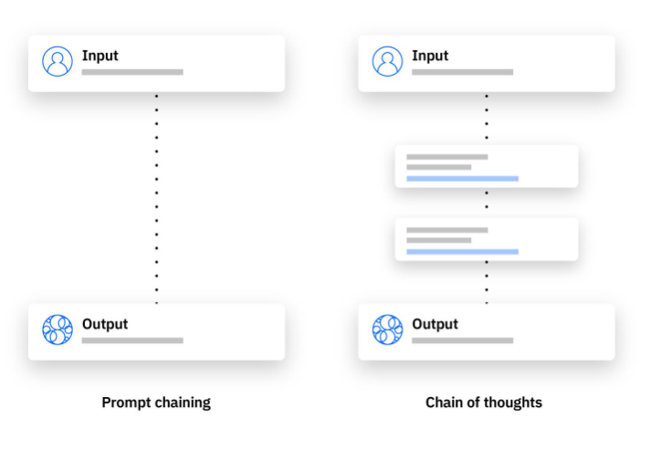
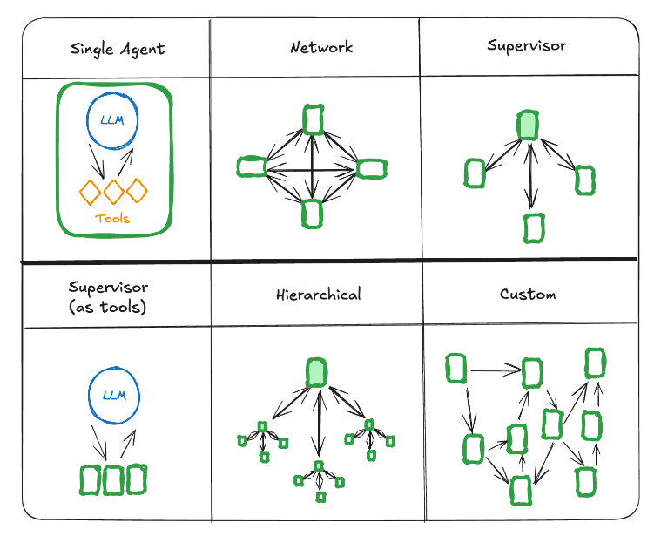
Common architectures
Chain of thoughts
Multi-agent
What is chain of thought (CoT) prompting? | IBM
langchain-ai.github.io

Slide 29
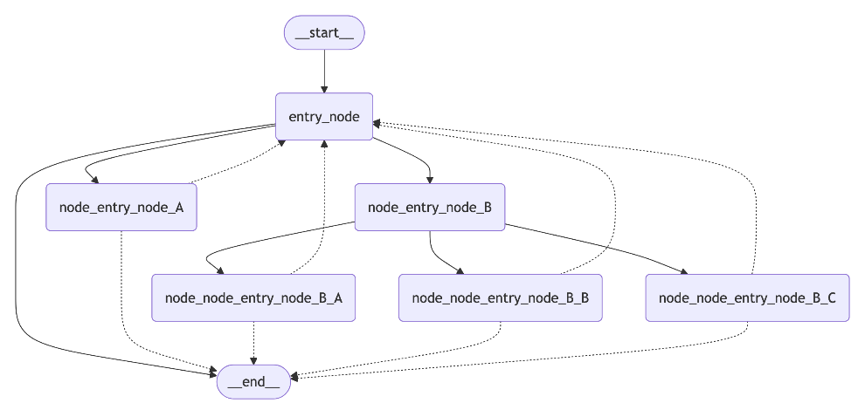
Langgraph
Easy way
Notes:
Source: Use the Graph API

Slide 30
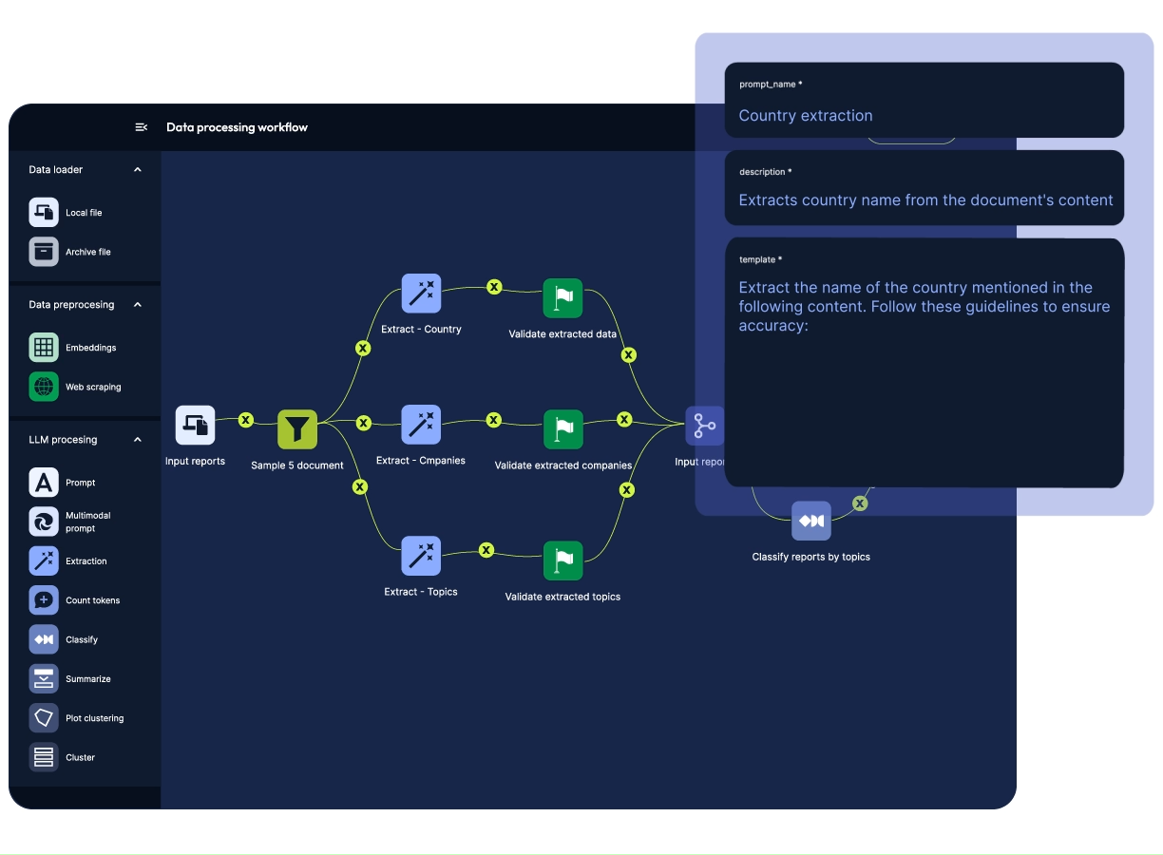
G.Workflow
Data-friendly way
Notes:
Source: https://grapeup.com/services/generative-ai/

Slide 31





Custom way
Pick tech stack for your need
Python is state-of-the-art AI language. But if the AI is just an API call, consider using Java with much better performance at high load.
Choose models you need
Consider cost reduction by using „mini” models or even self hosted ones. Consider fine-tunned models for domain-specific language.
Don’t use a sledgehammer to crack a nut
Use your own logic instead of LLM when possible. Don’t use agents if you could use tools instead.
Mind the I/O
Most of your application CPU time is waiting. Keep it in mind when designing the application.

Slide 32

It’s a long way from PoC to production

Slide 33
Chatbot Application
Easy to start, hard to master
Dr. Damian Petrecki, BEng, Msc, PhD
Grape Up Sp. z o.o. | Kraków, Poland | damian.petrecki@grapeup.com

